Slide 1
Spatial Model /Metapopulation Model
Cristina Lanzas and Shi Chen
CBS 810 Infectious disease modeling

Slide 2
Learning objectives
Enumerate existing modeling approaches for infectious disease transmission that has spatial components;
Explain basic ideas in metapopulation model;
Formulate metapopulation model.

Slide 3
What We’ve Learned So Far
Compartment Model Family
Simple SI/SIS/SIR Model (single pathogen/one host)
Zoonotic/Multi-host Disease Model
Vector-borne Disease Model
Macroparasite Model
Multi-strain Model
Notes:
Models become more and more complicated and shall deal with more realistic problems: homogeneous population? Homogeneous interaction? Differential equation: dS/dt
T is only one dimension; we live in the three-dimension world. So spatial component shouldn’t be ignored.

Slide 4
Why Do We Need Spatial Model?
Local Disease Spread
Heterogeneous distribution of host/pathogen/environment interaction
Effect of local interactions for initial spread
Control Strategies/ Intervention

Slide 5
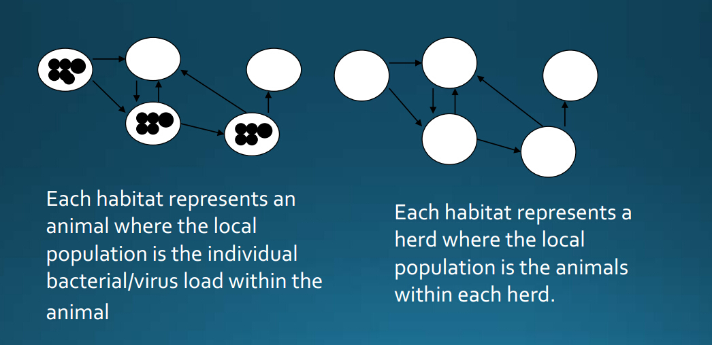
Metapopulation Models
A metapopulation is a group of populations that are separated by space but consist of the same species. These spatially separated populations interact as individual members move from one population to another.
Notes:
Not all individuals are equal (true for disease transmission)
We have mobile and static populations

Slide 6
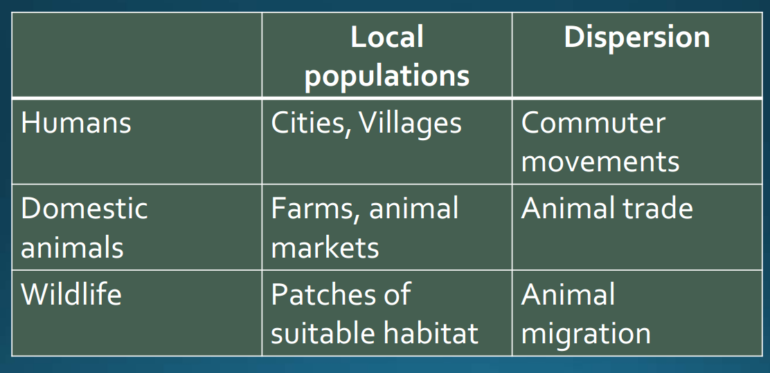
Host Population and Interactions
Notes:
“Interaction” is the word for “transmission”

Slide 7
Major Types of Metapopulation Model
Cross-coupled Model
Do not incorporate explicit mobility among populations
Incorporate the strength of contact within/between populations
Mobility Model
Movement of individuals is modeled
Commuting or permeant migration as two most important movements

Slide 8
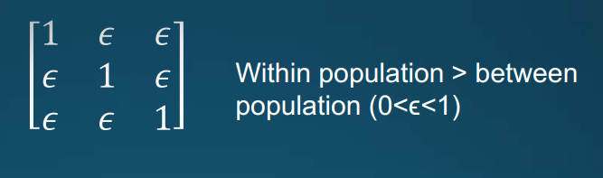
Cross-coupled Metapopulation Model
Strength of interaction is incorporated in the force of infection using WAIFW matrices (spatially implicit)
Other factors such as wind or vector-borne diseases, interaction depends on distance (spatially explicit)

Slide 9
Compartment Cross-Coupled Model
S1
I1
S2
I2

Slide 10
Cross-coupled Metapopulation Model

Slide 11
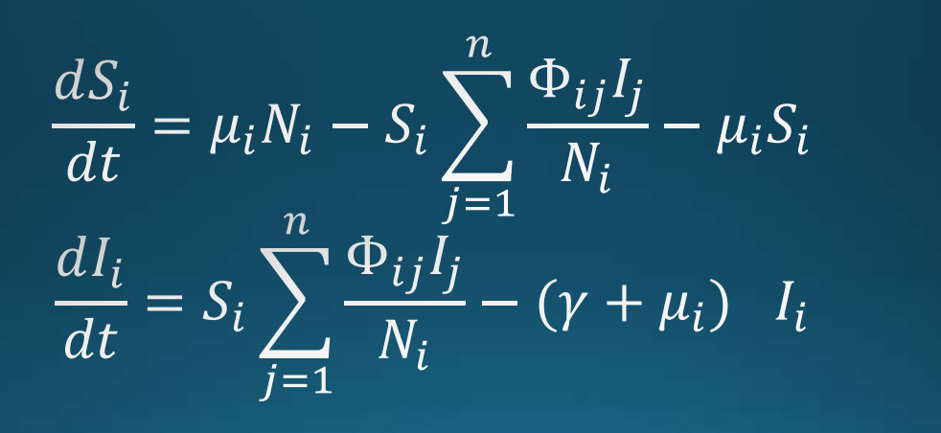
Cross-coupled Metapopulation Model

Slide 12
Compartment Mobility Model
S1
I1
S2
I2

Slide 13
Mobility Model (Migration)

Slide 14
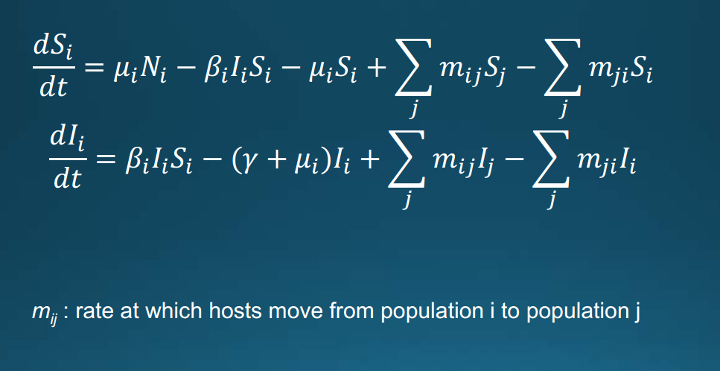
Mobility Model (Migration)

Slide 15
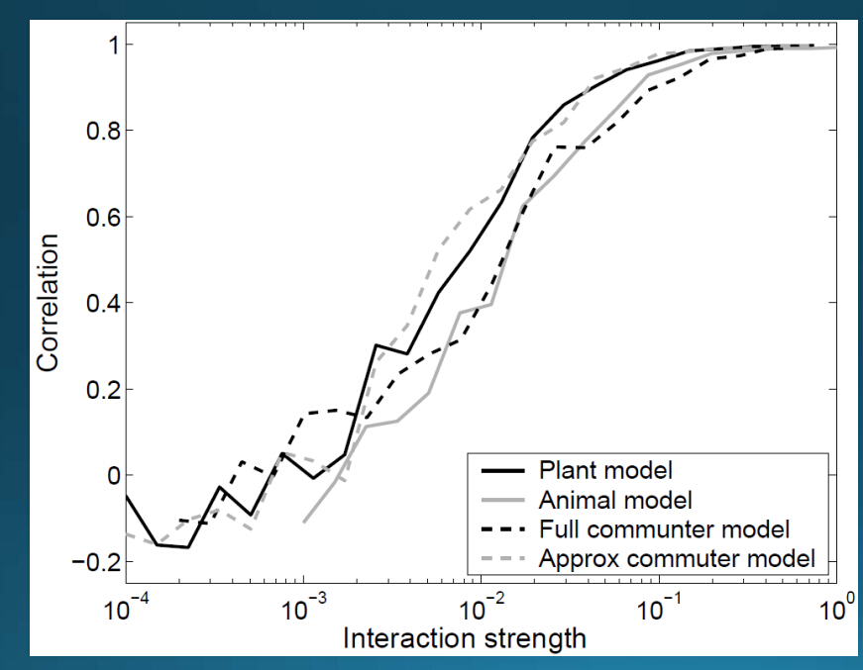
Coupling and Synchrony
Correlation between disease prevalence in two populations increases (sigmoidally) with the strength of interaction between subpopulations.

Slide 16
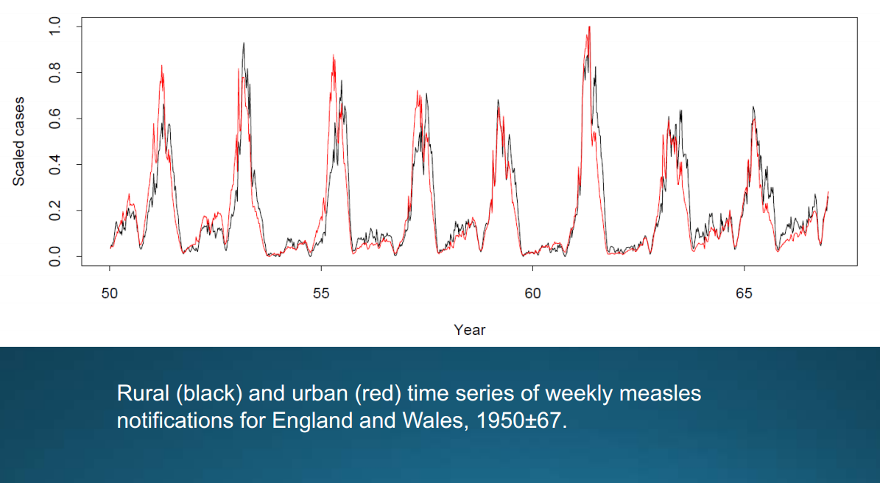
Coupling and Synchrony

Slide 17
Other Spatial Models for Disease Transmission
Partial Differential Equations (Diffusion Model)
Cellular automata/Lattice Model
Agent-Based Model (ABM)
Network Model

